Slide 1
Chongqing University of Technology
ATAI
Advanced Technique of Artificial Intelligence
Chongqing University of Technology
WWW_2021
https://github.com/behavioral-data/PARTNER
Hongyang Song

Slide 2
Outline
Motivation
Approach
Experiments
Conclusion

Slide 3
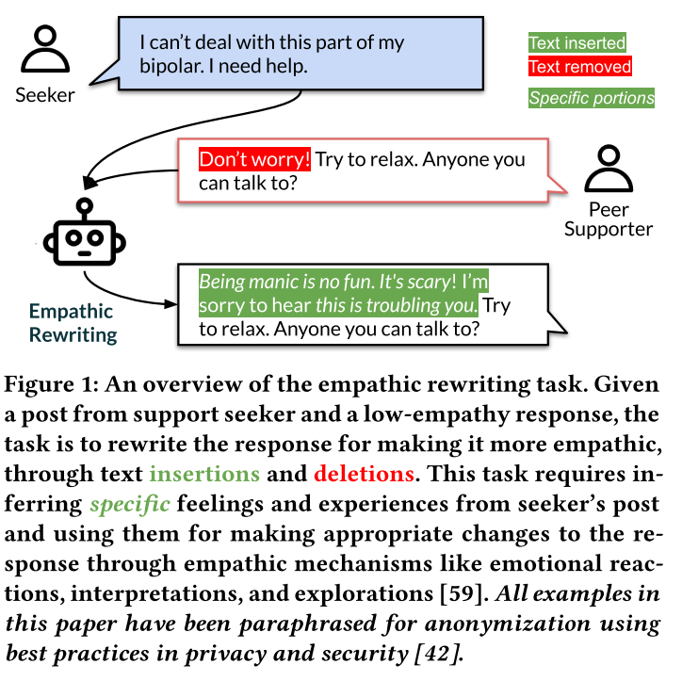
Motivation

Slide 4
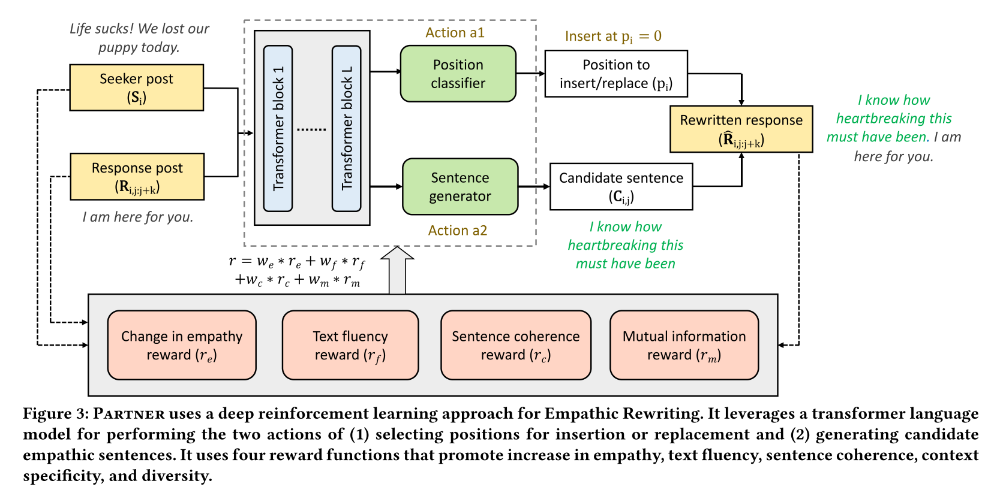
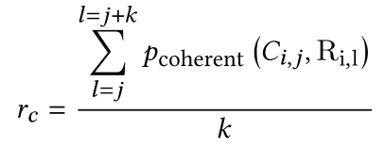
Approach
Notes:
生活糟透了!今天我们的小狗丢了

Slide 5
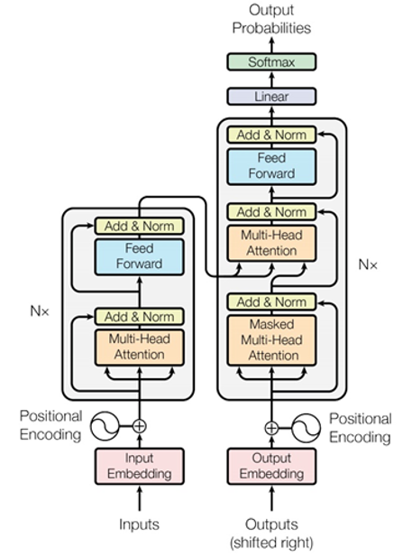
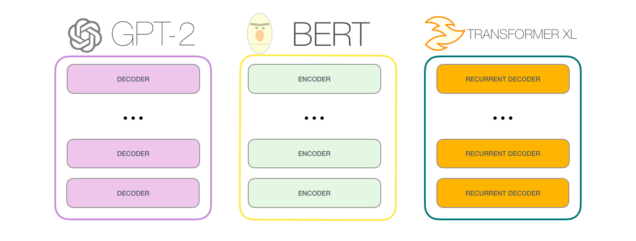
Approach

Slide 6
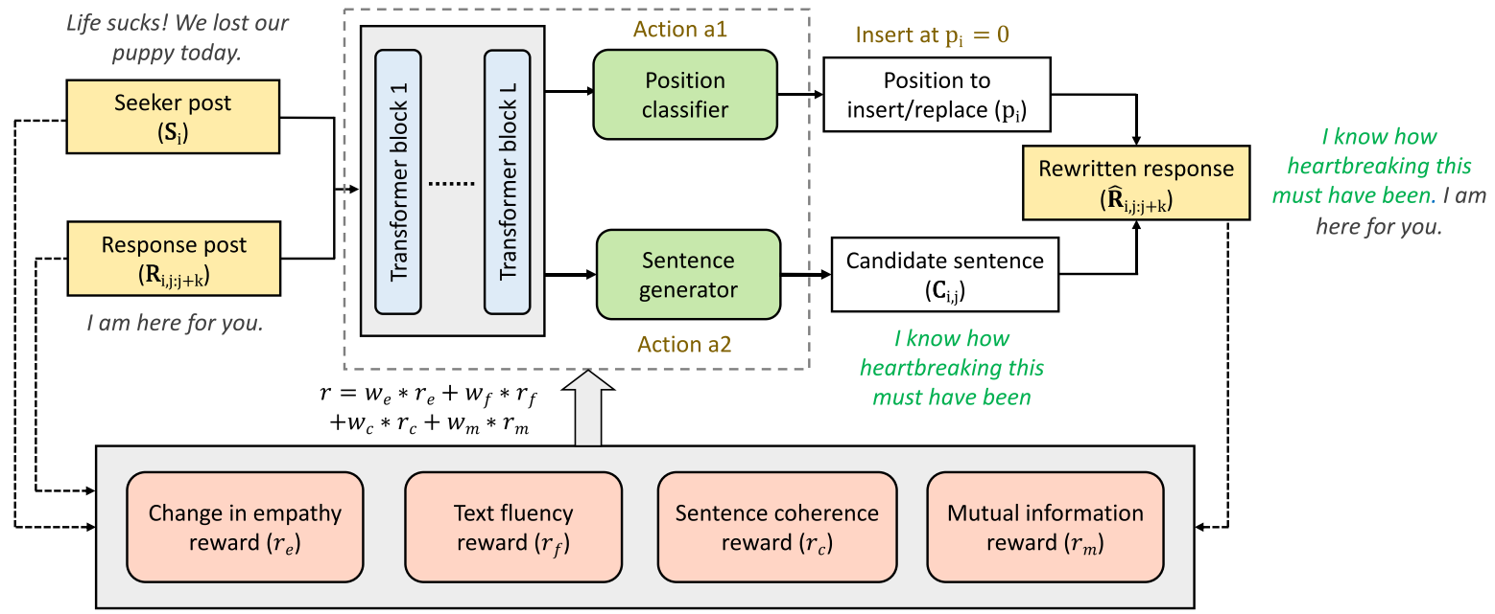
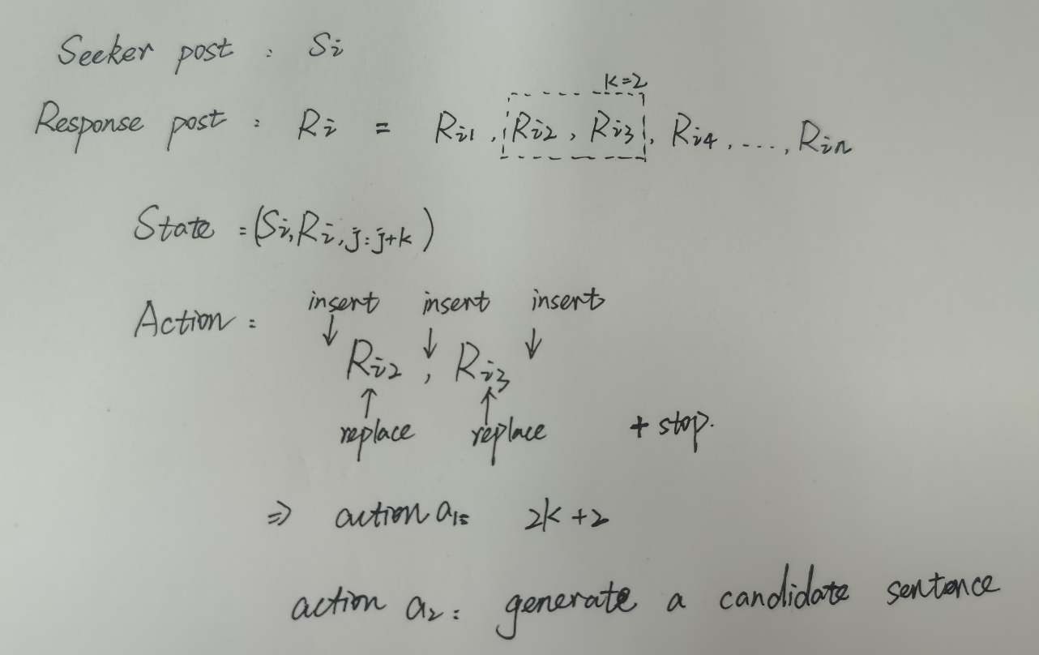
Approach
ICLR-2020_The curious case of neural text degeneration

Slide 7
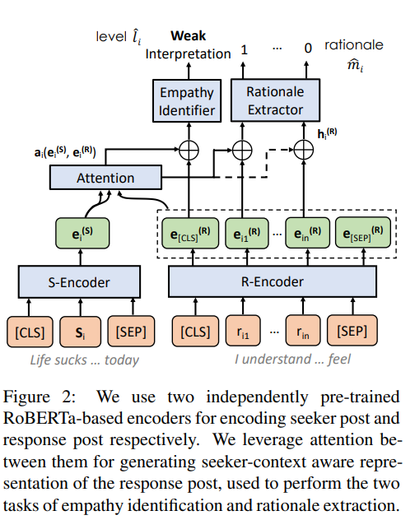
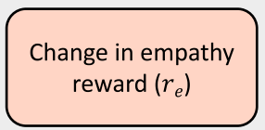
Approach
EMNLP_2020_A Computational Approach to Understanding Empathy Expressed in Text-Based Mental Health Support
共情变化

Slide 8
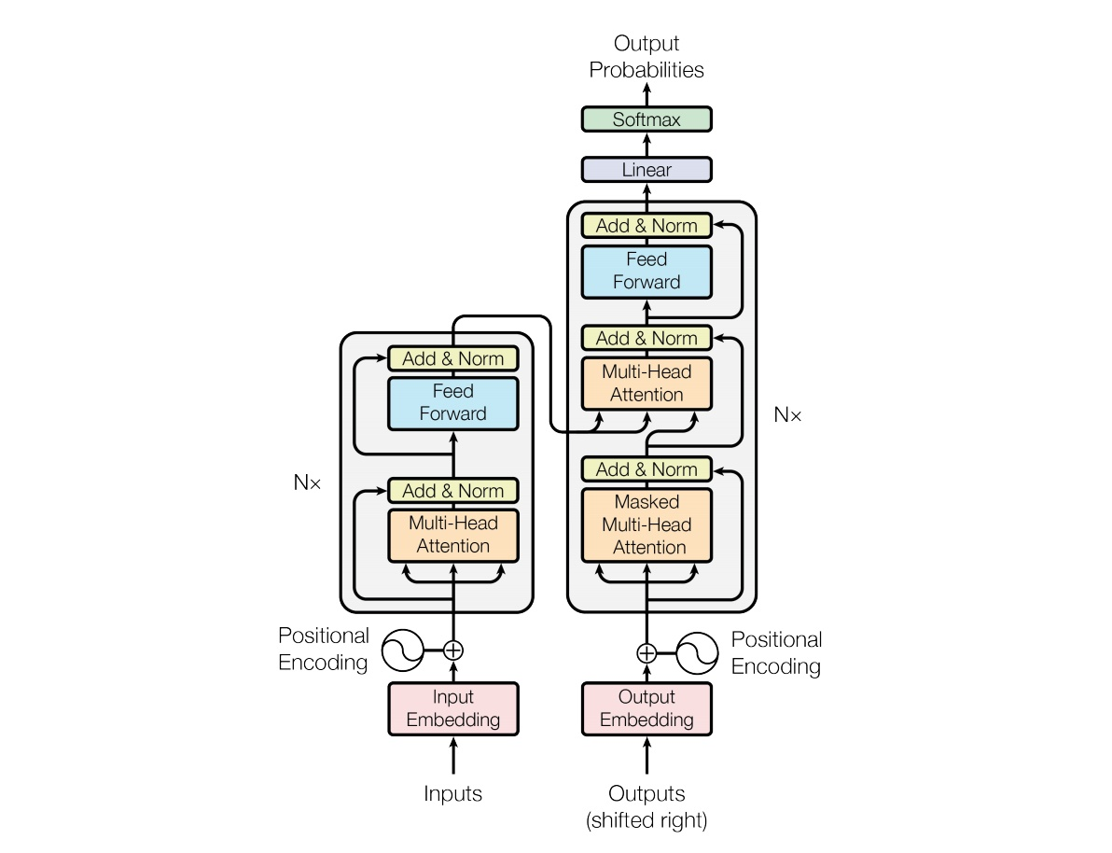
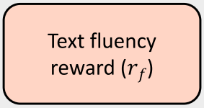
Approach
文本流利度

Slide 9
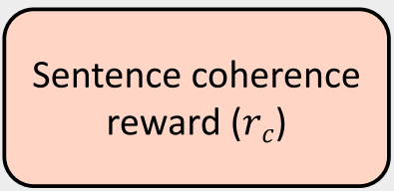
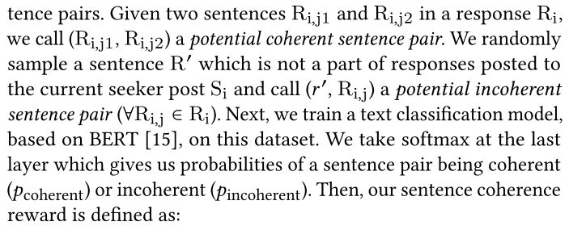
Approach
句子间连贯性

Slide 10
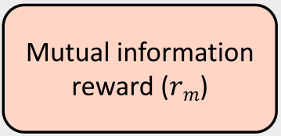
Approach
特异性和多样性的共同信息
“I understand how you feel”
EMNLP_2016_Deep Reinforcement Learning for Dialogue Generation
Notes:
句子的连贯性

Slide 11
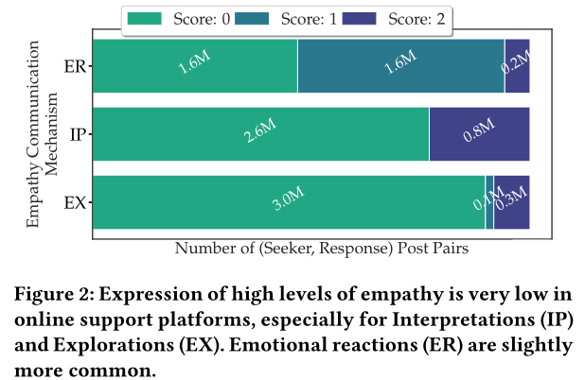
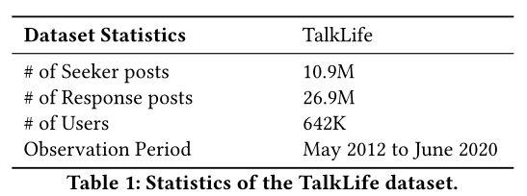
Experiments
Emotional Reactions
(expressing emotions such as warmth, compassion)
Interpretations
(communicating an understanding of feelings and experiences)
Explorations
(improving understanding of the seeker by exploring feelings and experiences)
EMNLP_2020_A Computational Approach to Understanding
Empathy Expressed in Text-Based Mental Health Support
Notes:
表达温暖、同情等情感
沟通对感觉和经历的理解
通过探索感受来增进对探索者的理解

Slide 12
Distincts compute the number of distinct unigrams and bigrams respectively divided by the total number of tokens.
Notes:
Levenshtein distance

Slide 13
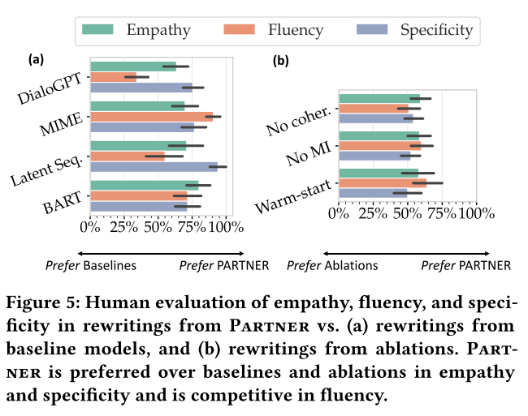
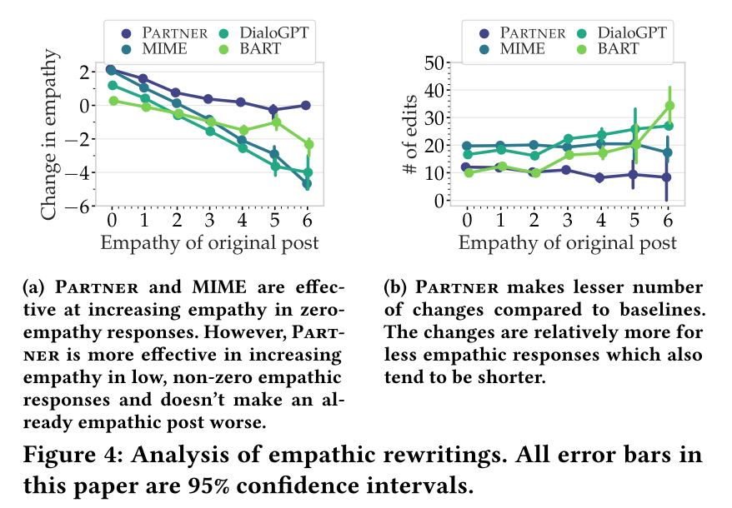
Experiments

Slide 14
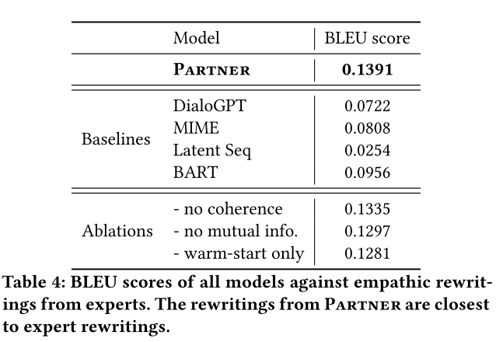
Experiments

Slide 15
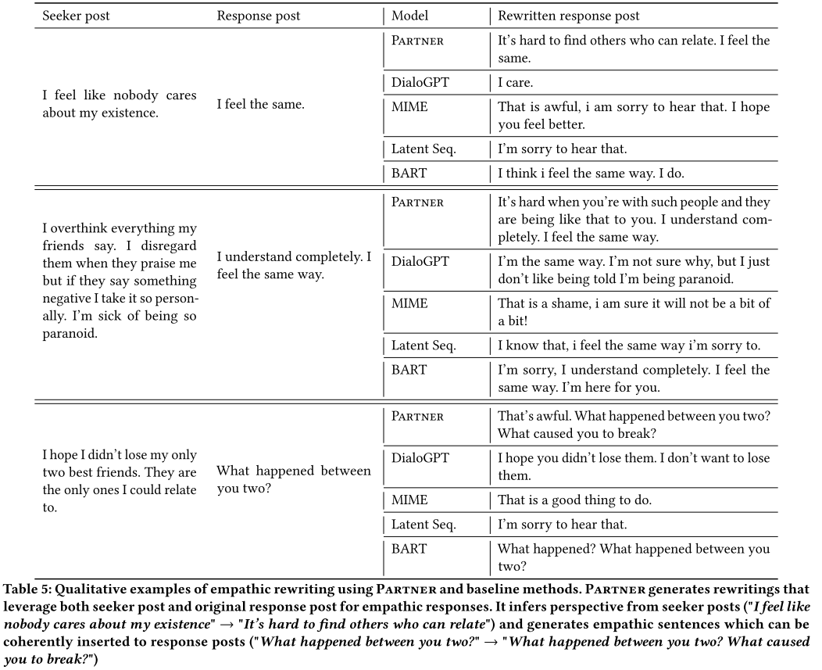
Experiments

Slide 16
Thanks

